Slide 1
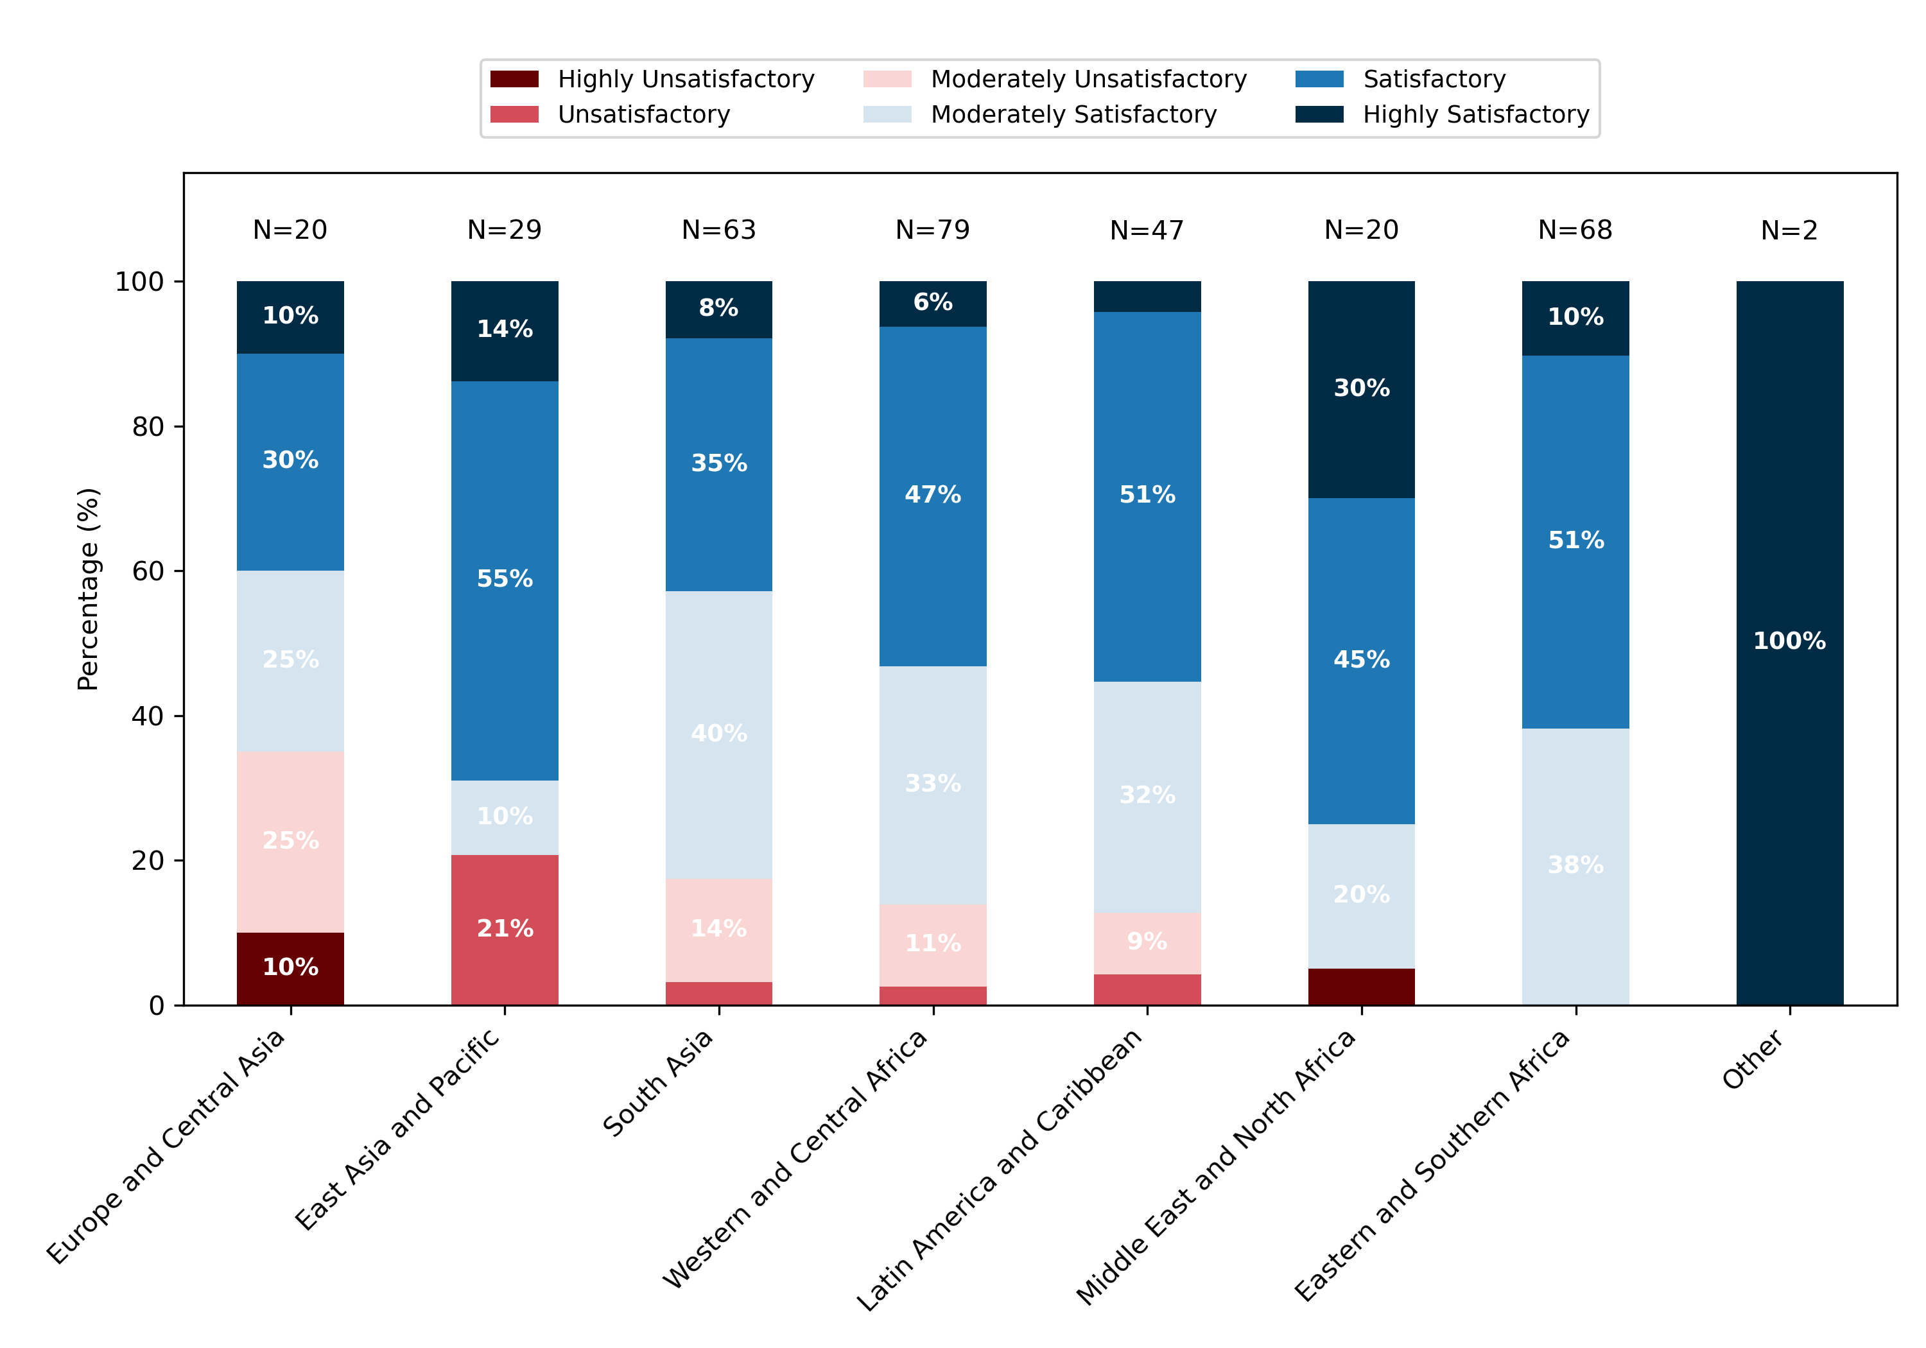
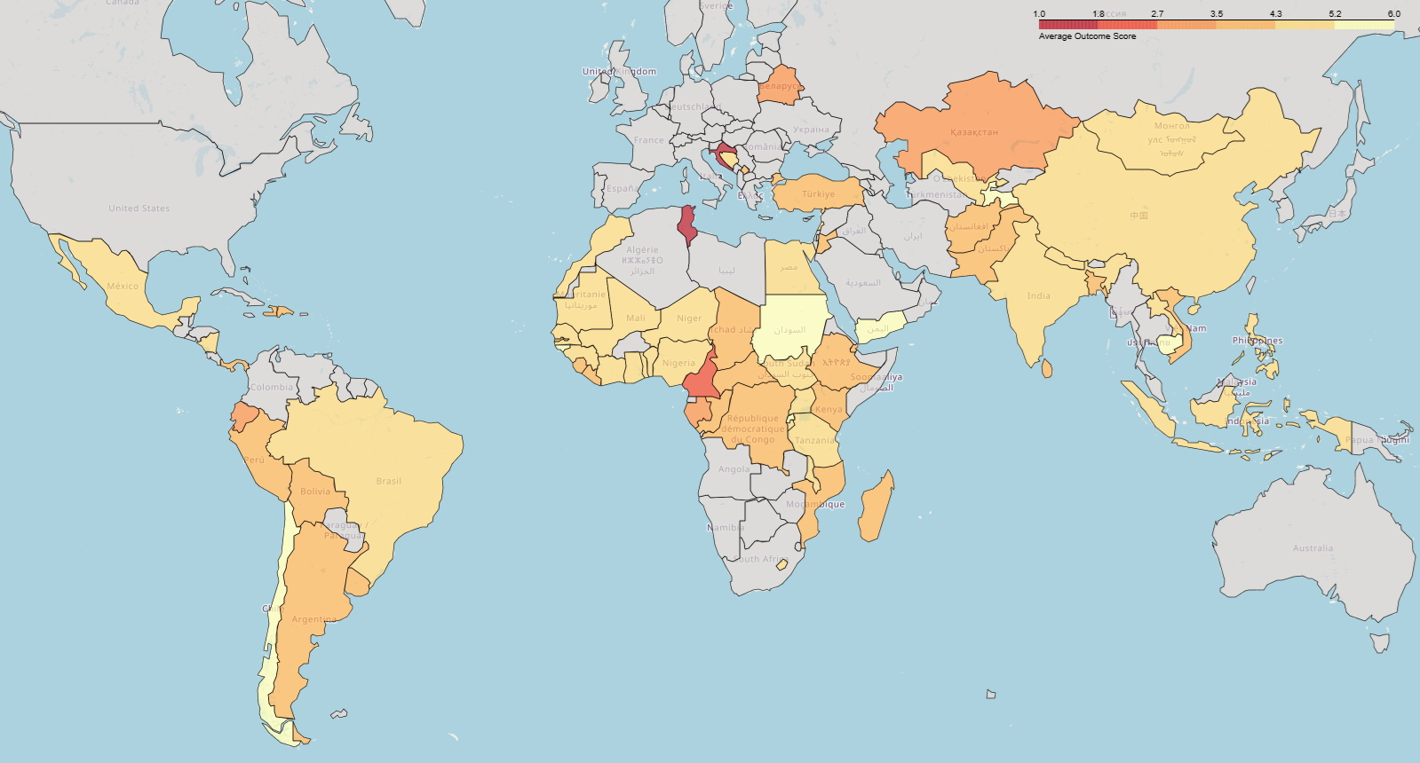
Figure 1. Distribution of Outcome Ratings by Region (%)
Map 1. Average Outcome Rating by Country (1 = Worst, 6 = Best).

Slide 2
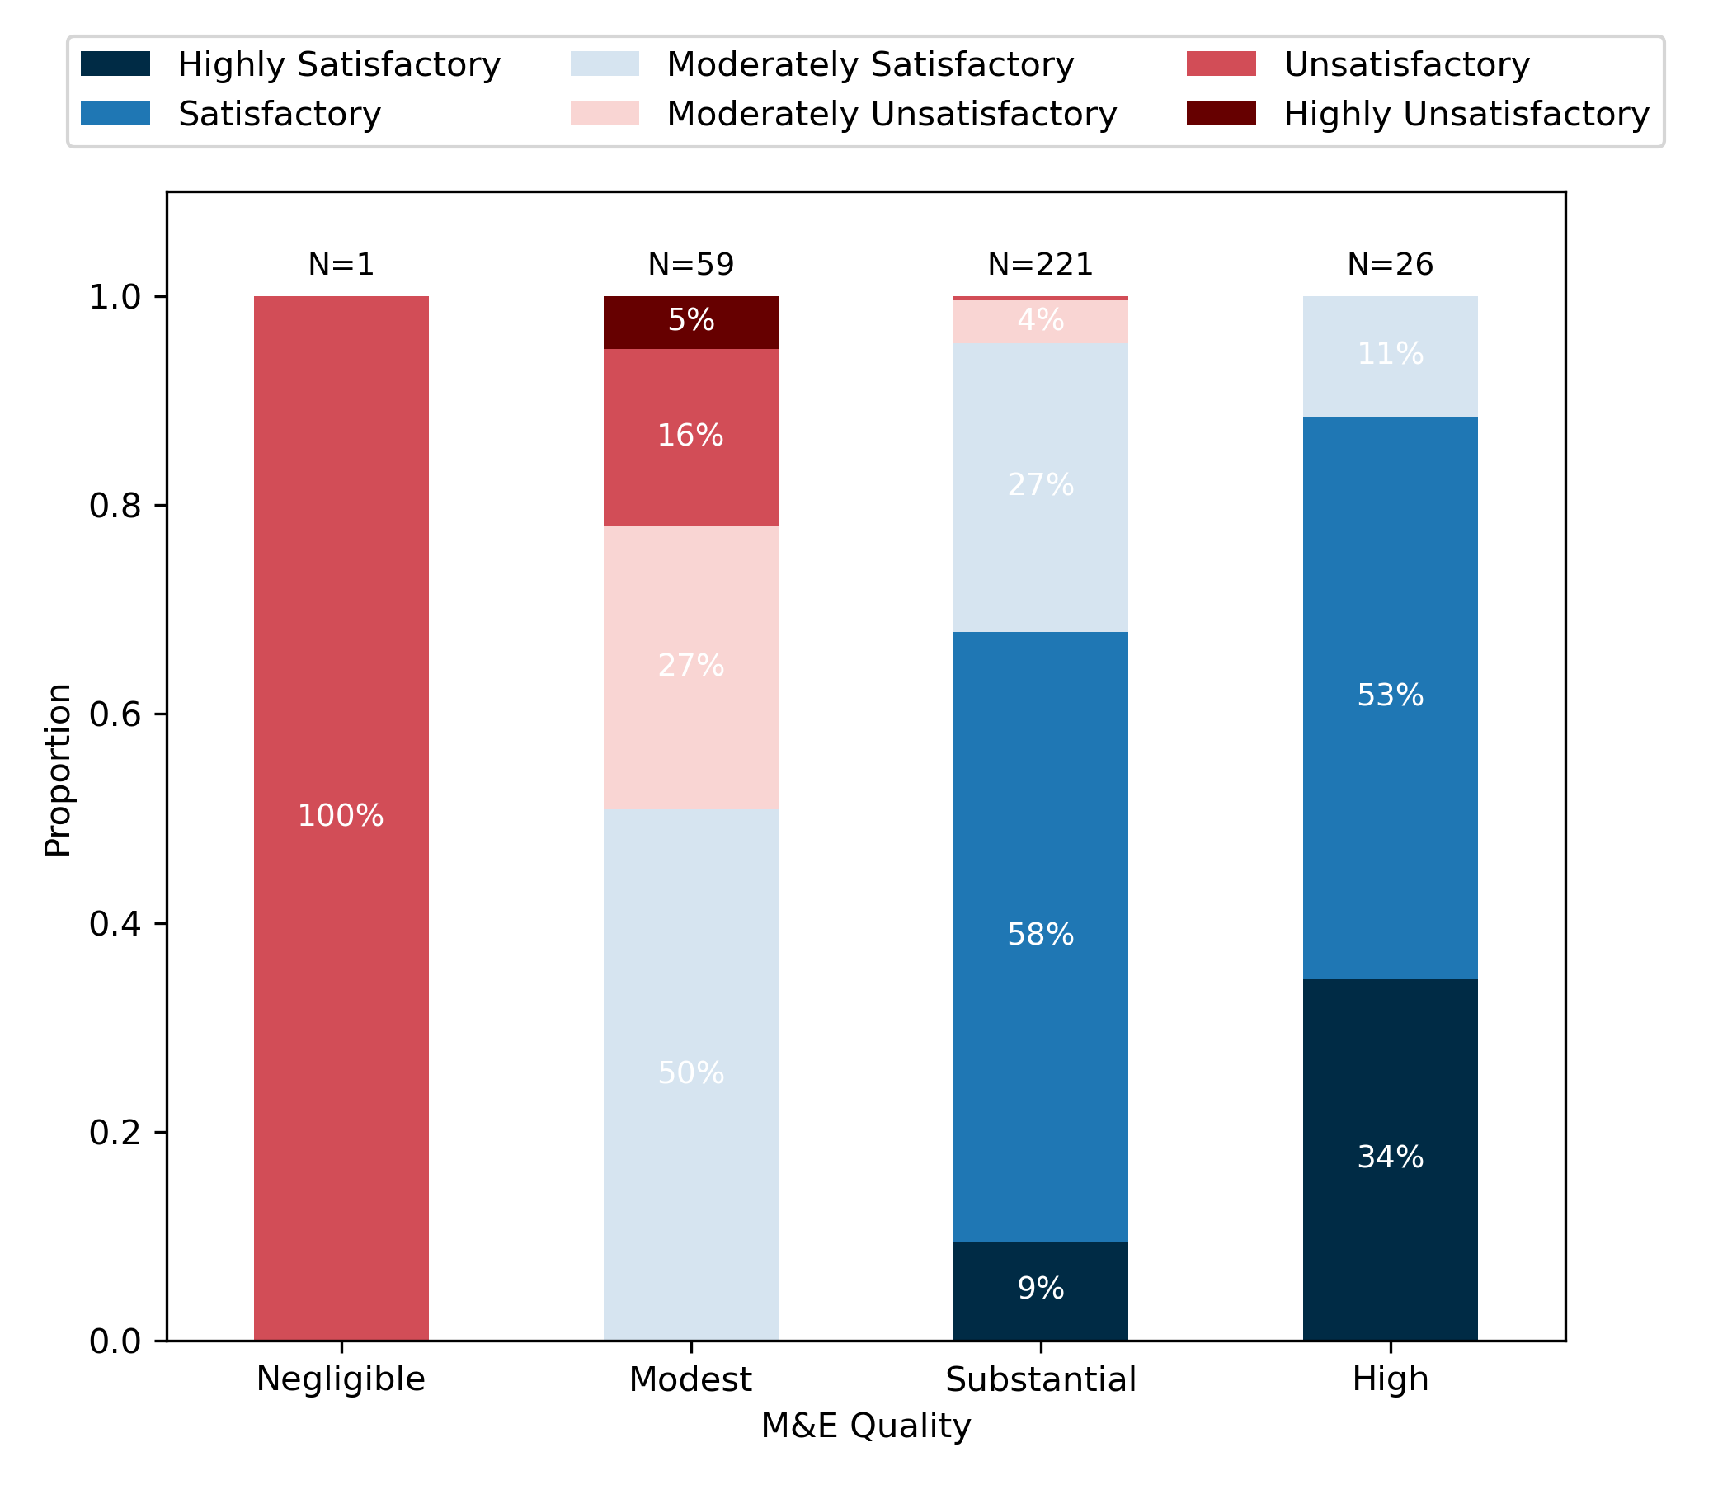
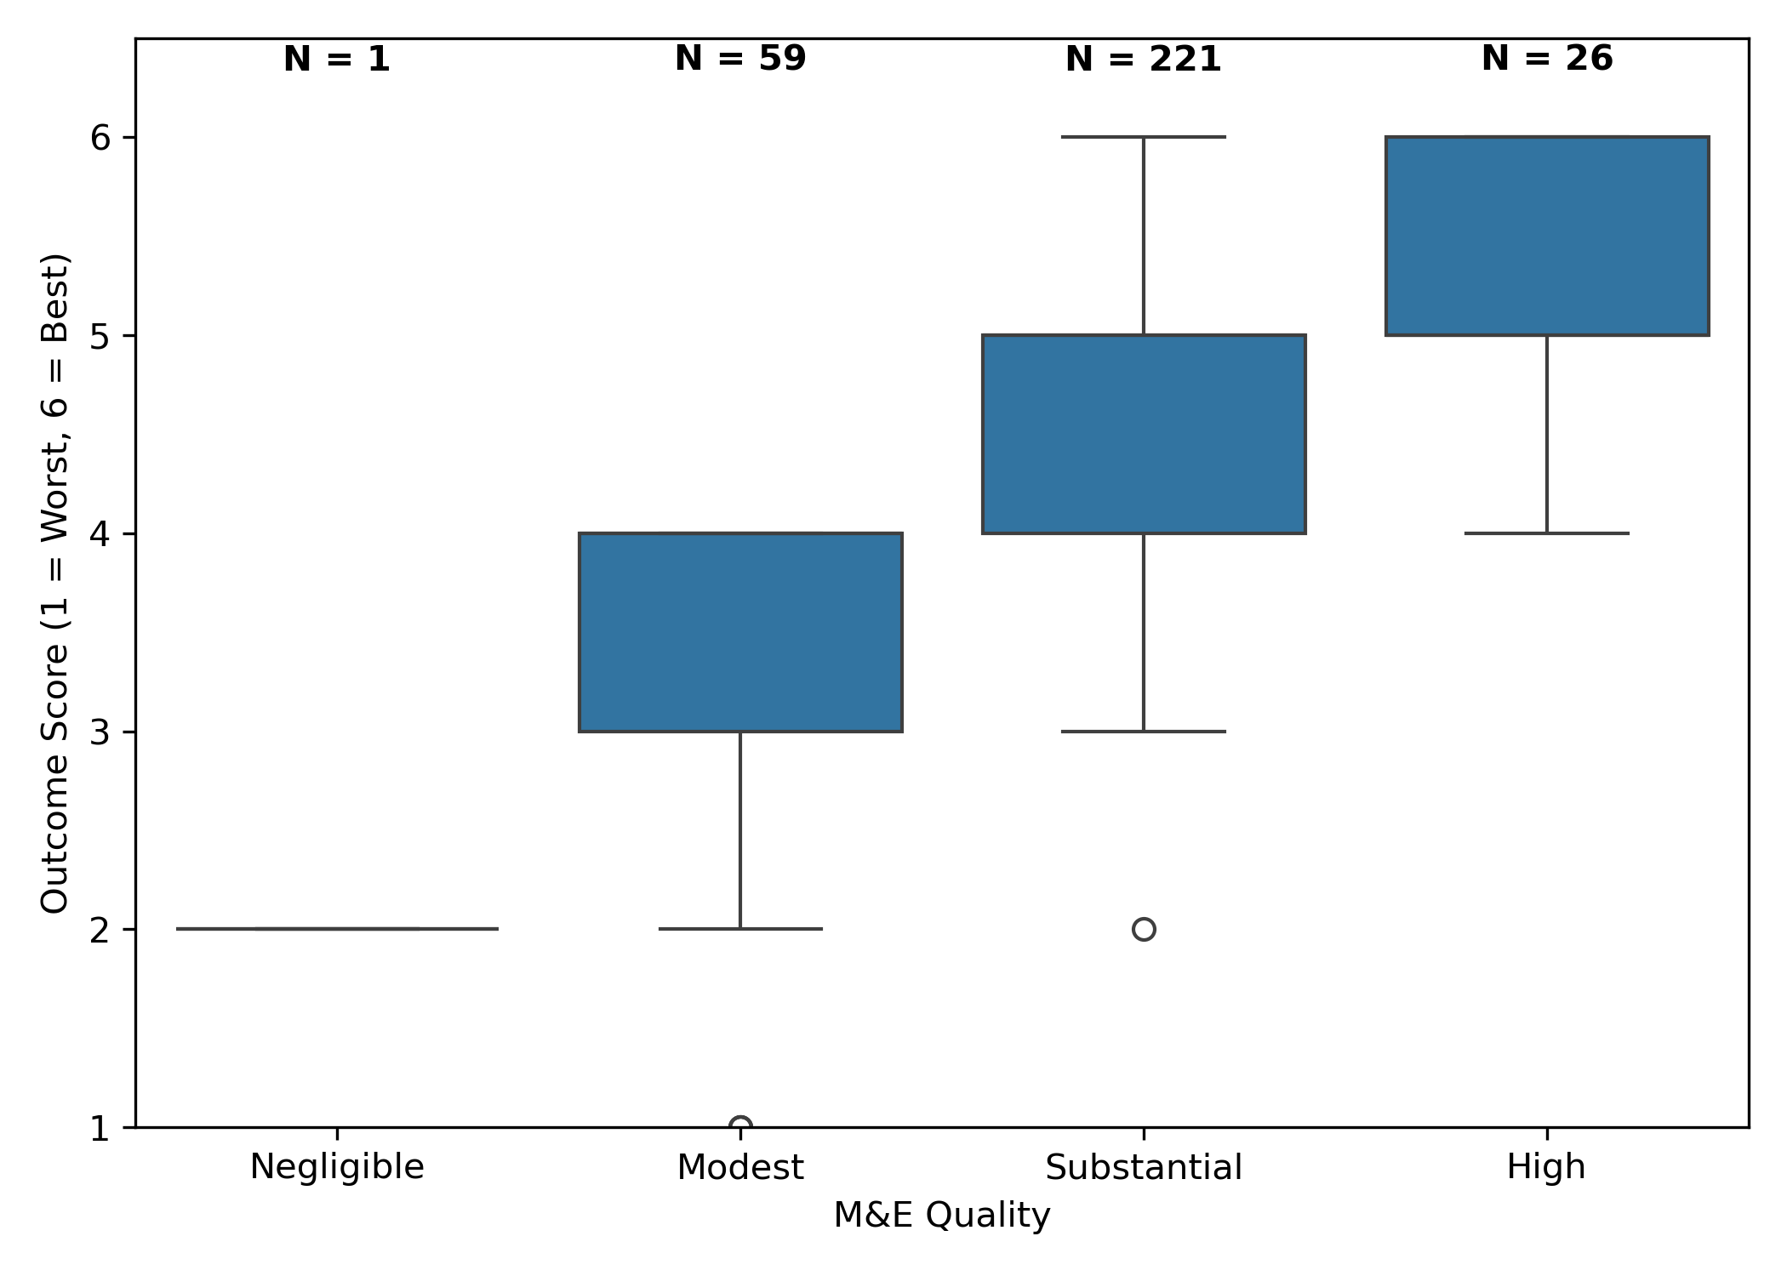
Figure 2. Outcome Rating Distribution Across M&E Quality Levels
Figure 3. Mean Outcome Rating (Scale: 1 = Worst, 6 = Best): Median and Variability by M&E Quality

Slide 3
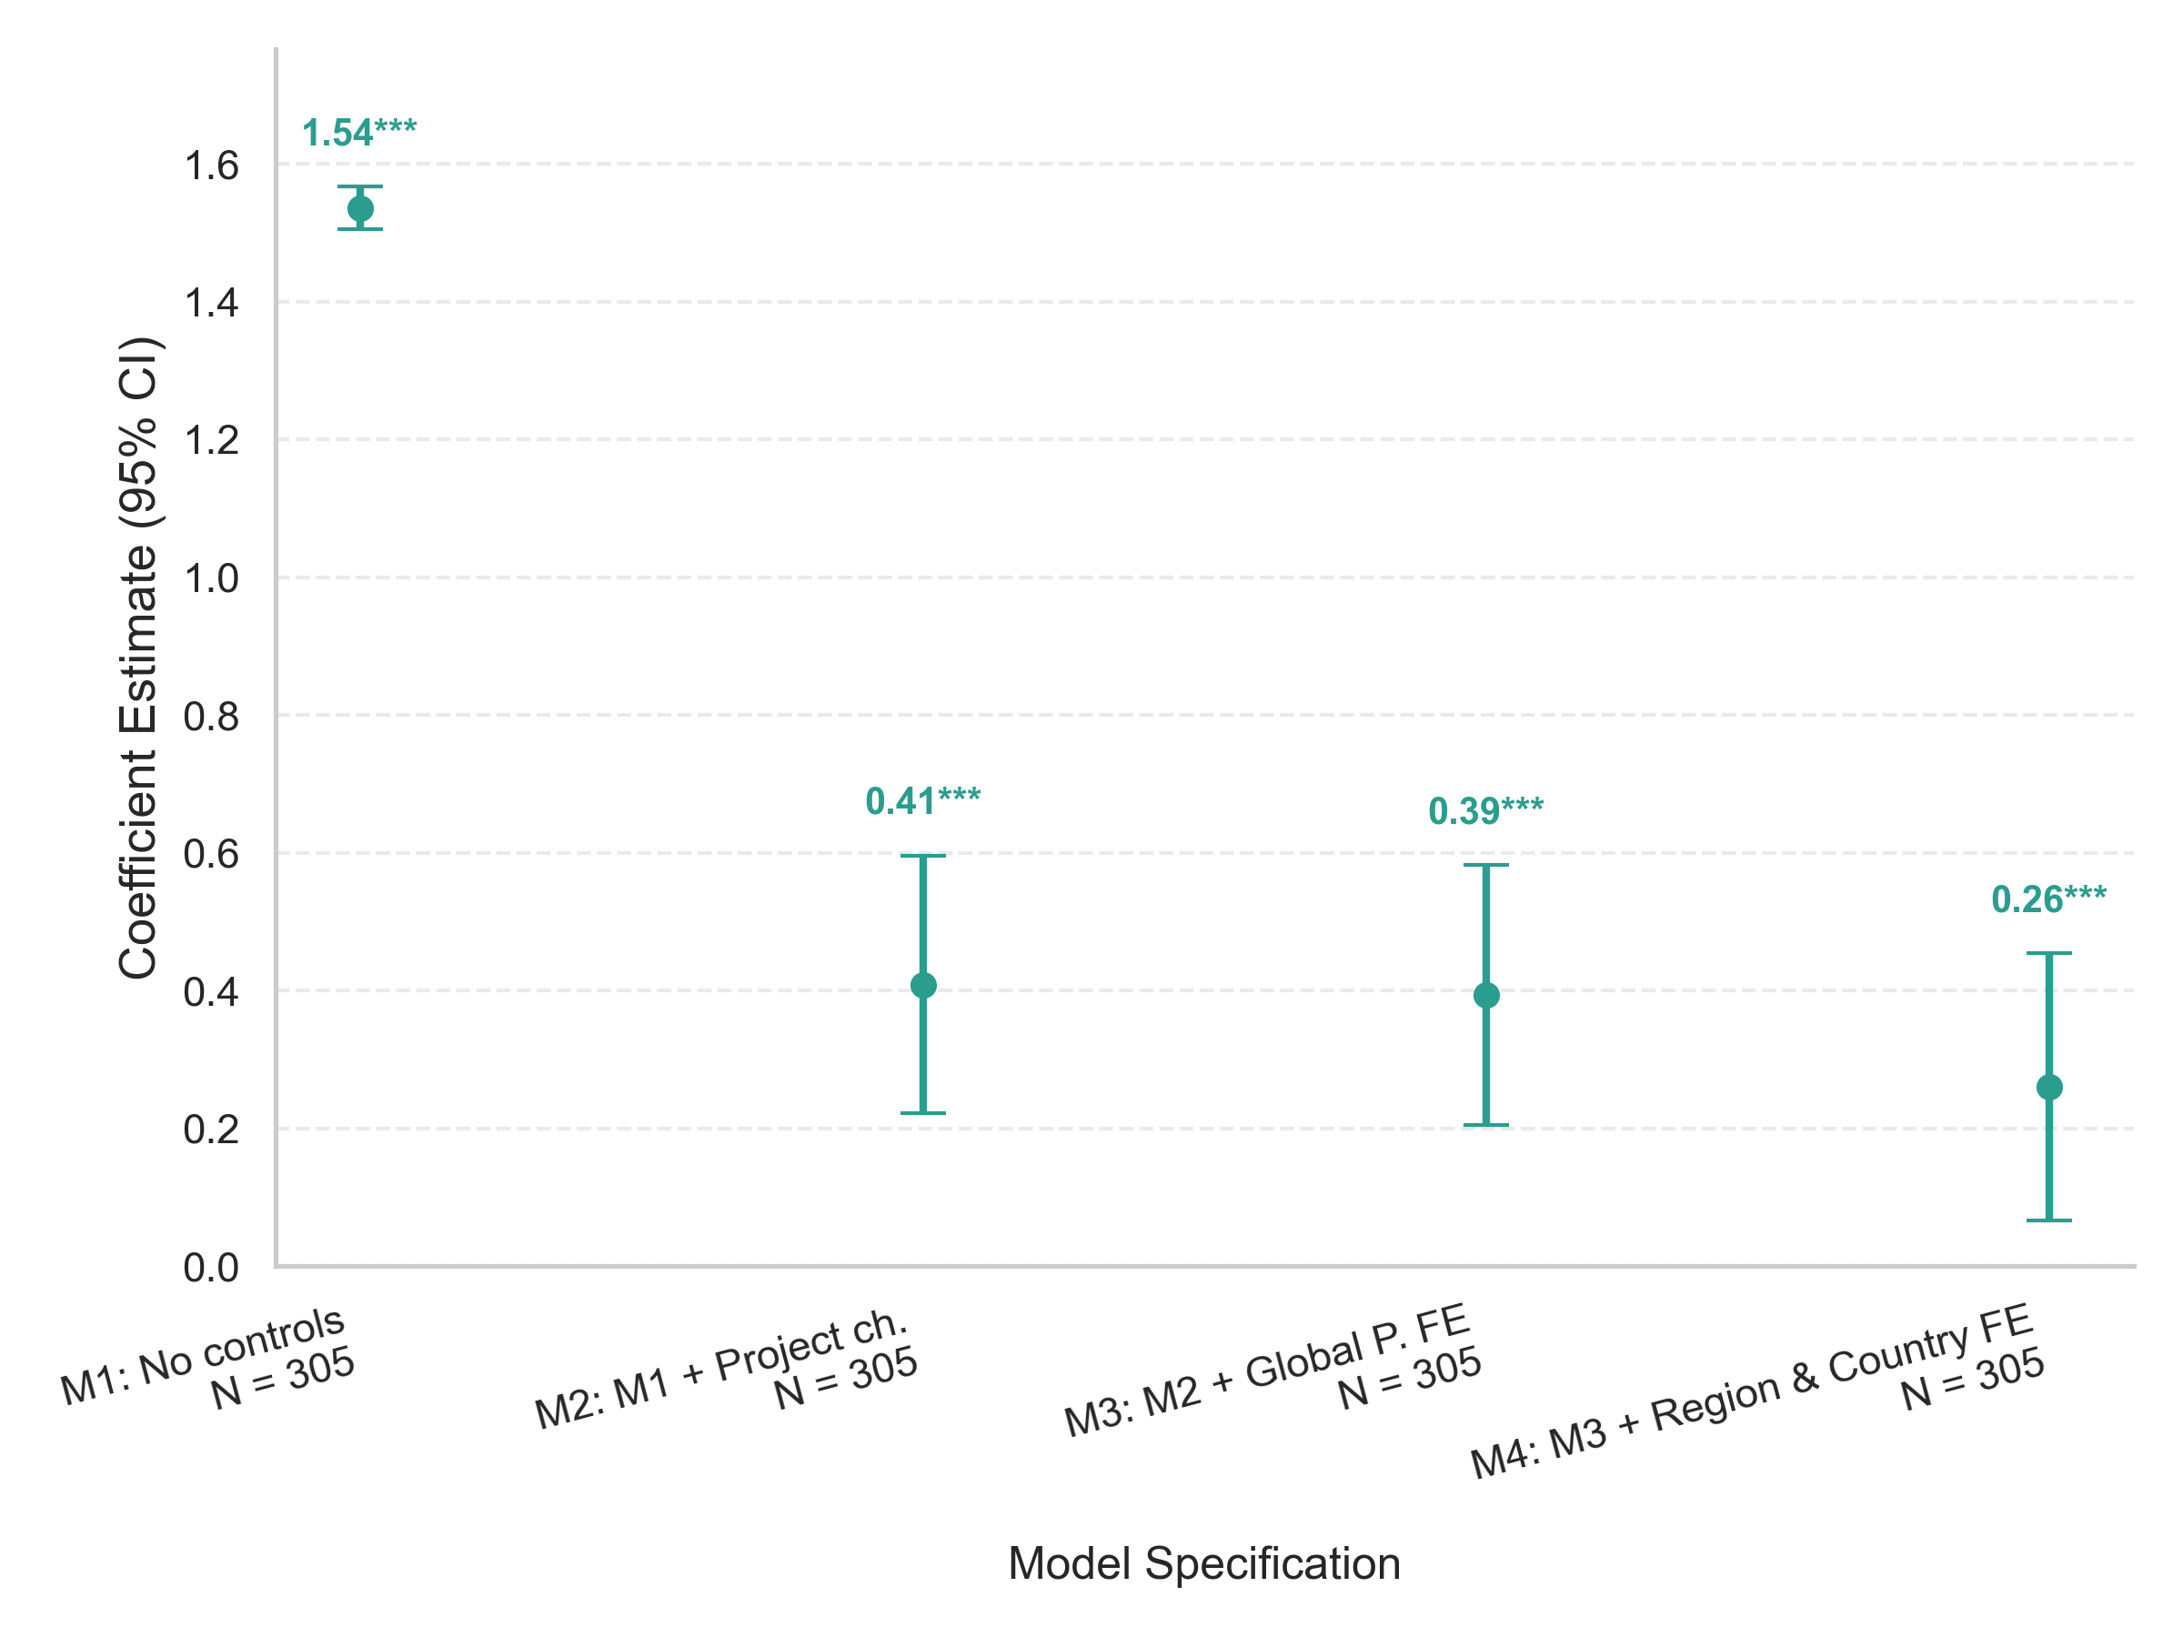
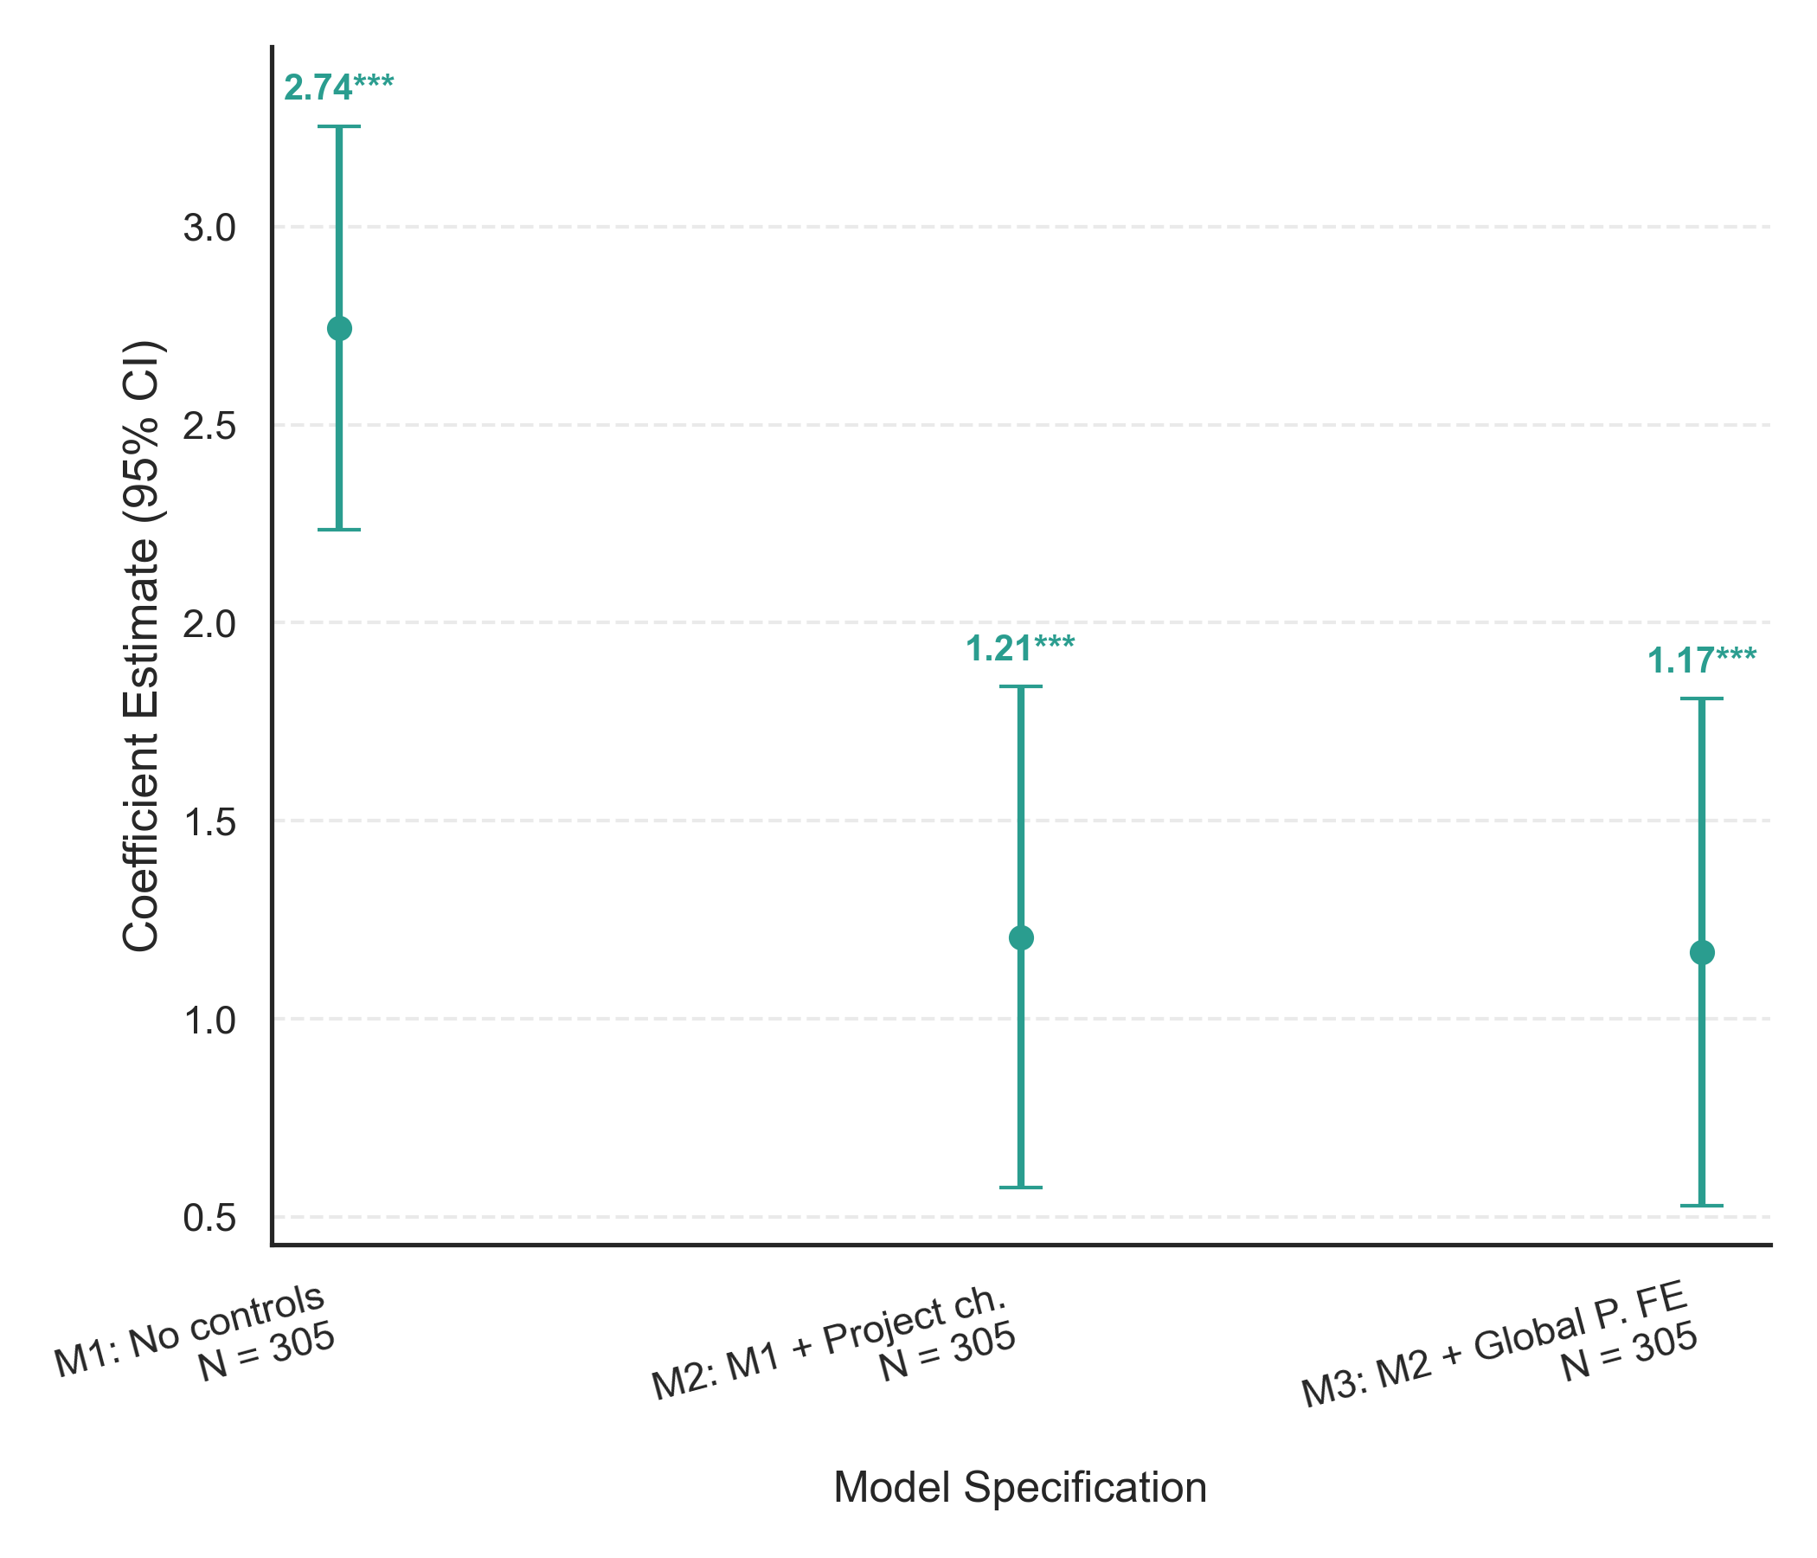
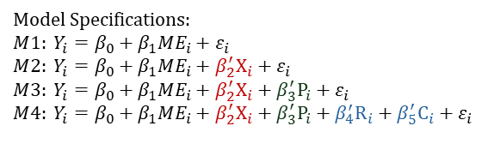

Figure 4. OLS estimation of the effect of M&E Quality on Outcome Ratings.
Figure 5. Ordered Logit estimation of the effect of M&E Quality on Outcome Ratings.
Model Specifications: $$M1: Y_{i}=β_{0}+β_{1}{ME}_{i}+ε_{i} \\ M2: Y_{i}=β_{0}+β_{1}{ME}_{i}+β_{2}^{′}X_{i}+ε_{i}$$
$$M3: Y_{i}=β_{0}+β_{1}{ME}_{i}+β_{2}^{′}X_{i}+β_{3}^{′}P_{i}+ε_{i}$$
$$M4: Y_{i}=β_{0}+β_{1}{ME}_{i}+β_{2}^{′}X_{i}+β_{3}^{′}P_{i}+β_{4}^{′}R_{i}+β_{5}^{′}C_{i}+ε_{i}$$
Model Specifications: $$M1: Y_{i}=β_{0}+β_{1}{ME}_{i}+ε_{i} \\ M2: Y_{i}=β_{0}+β_{1}{ME}_{i}+β_{2}^{′}X_{i}+ε_{i}$$
$$M3: Y_{i}=β_{0}+β_{1}{ME}_{i}+β_{2}^{′}X_{i}+β_{3}^{′}P_{i}+ε_{i}$$
$$M4: Y_{i}=β_{0}+β_{1}{ME}_{i}+β_{2}^{′}X_{i}+β_{3}^{′}P_{i}+β_{4}^{′}R_{i}+β_{5}^{′}C_{i}+ε_{i}$$

Slide 4
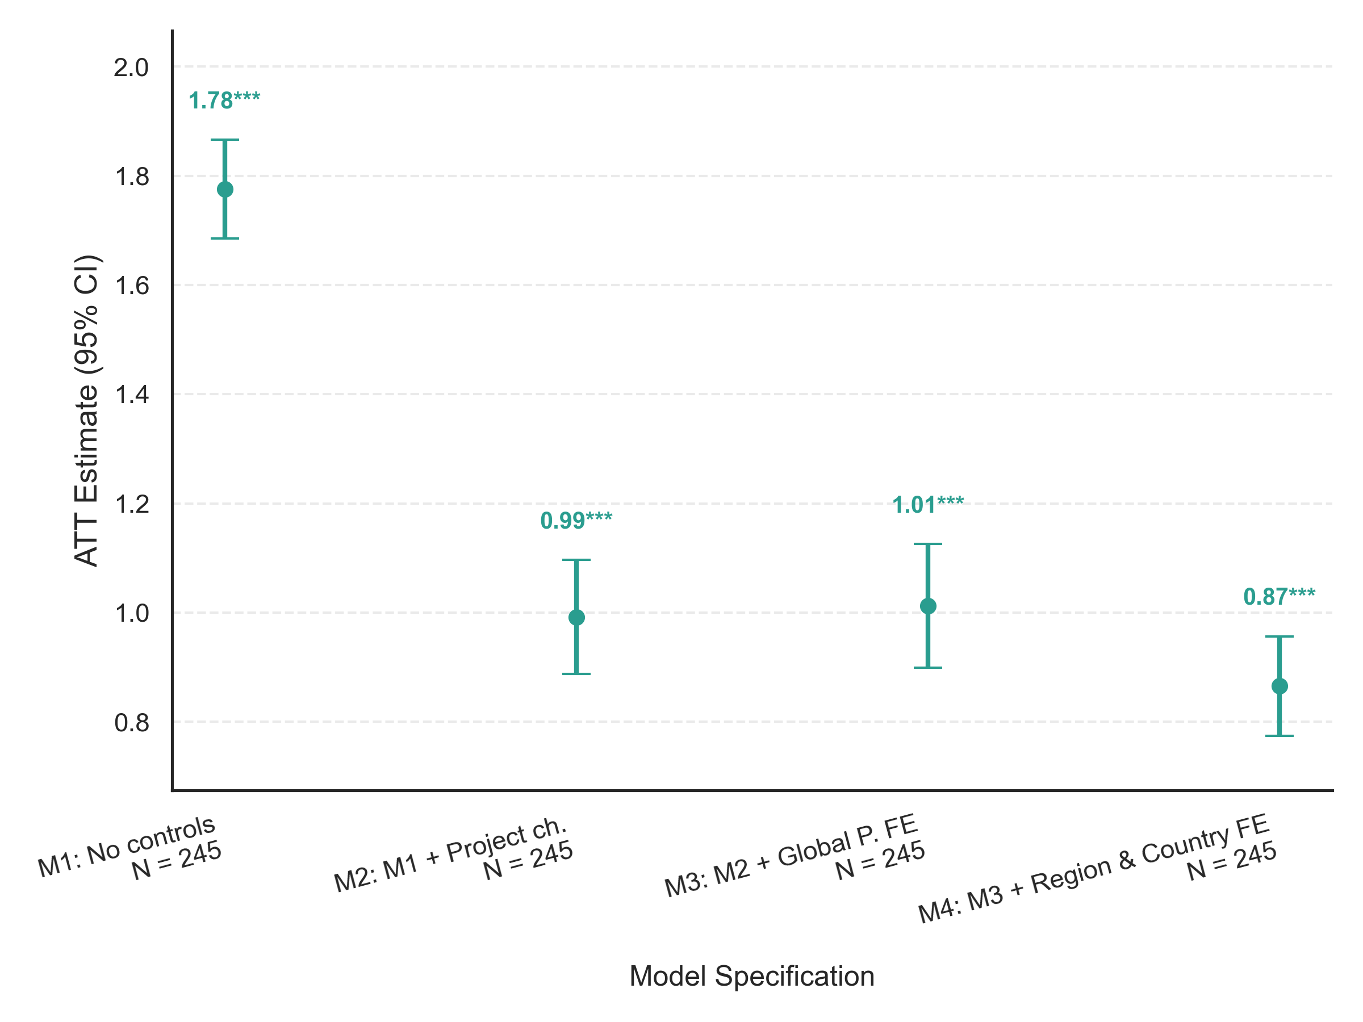
Figure 6. Average Treatment Effect on the Treated (ATT) estimation of the impact of M&E Quality on Outcome Ratings

Slide 5
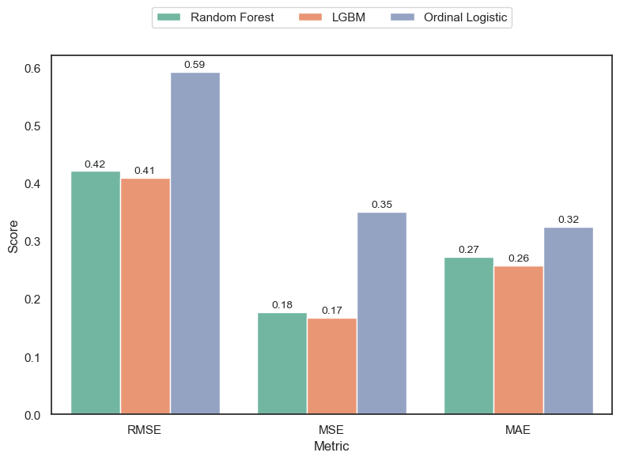
Figure 7. Performance metrics for predicting Outcome Ratings (1 = worst, 6 = best) using the best Random Forest, Gradient Boosting, and Ordinal Logit models.

Slide 6
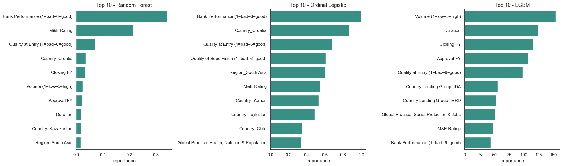
Figure 8. Feature importance in the best Random Forest, Gradient Boosting, and Ordinal Logit models.

Slide 7
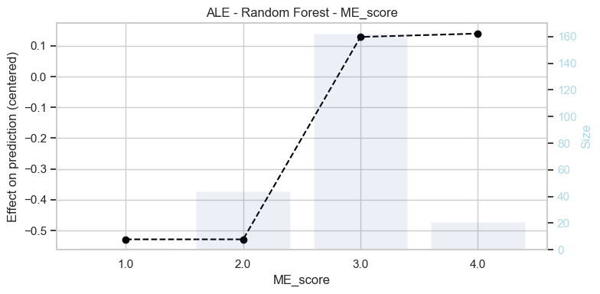
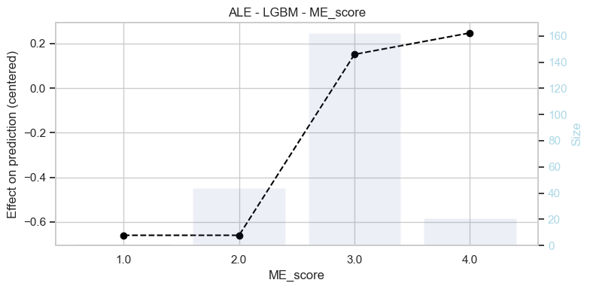
Figure 9. Accumulated Local Effects (ALE) estimated using the best Random Forest and Gradient Boosting models.

Slide 8
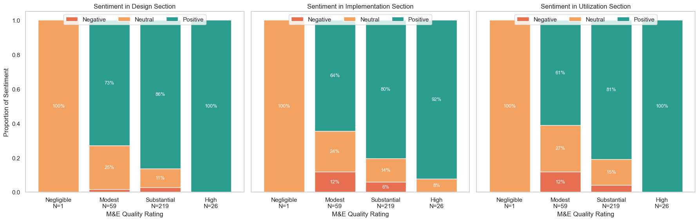
Figure 10. Sentiment analysis (Negative, Neutral, Positive) across the three sections of the M&E Evaluation (Design, Implementation, Utilization) by final M&E Quality rating.

Slide 9
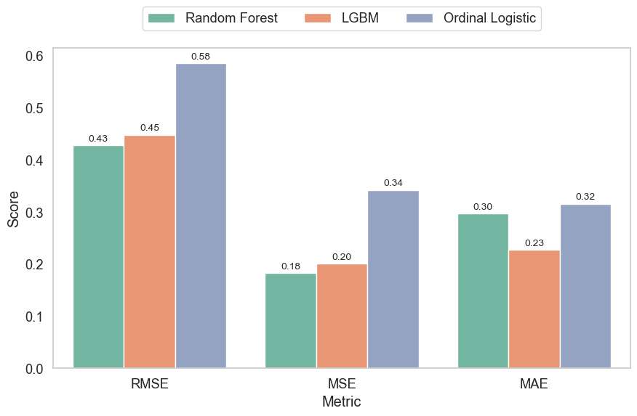
Figure 11. Performance metrics for the best Gradient Boosting, Random Forest, and Ordinal Logistic models after incorporating sentiment analysis.

Slide 10
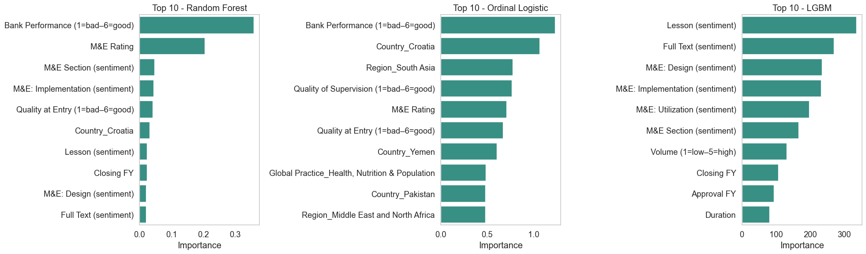
Figure 12. Feature importance in the best Random Forest, Gradient Boosting, and Ordinal Logit models after incorporating sentiment analysis.

Slide 11
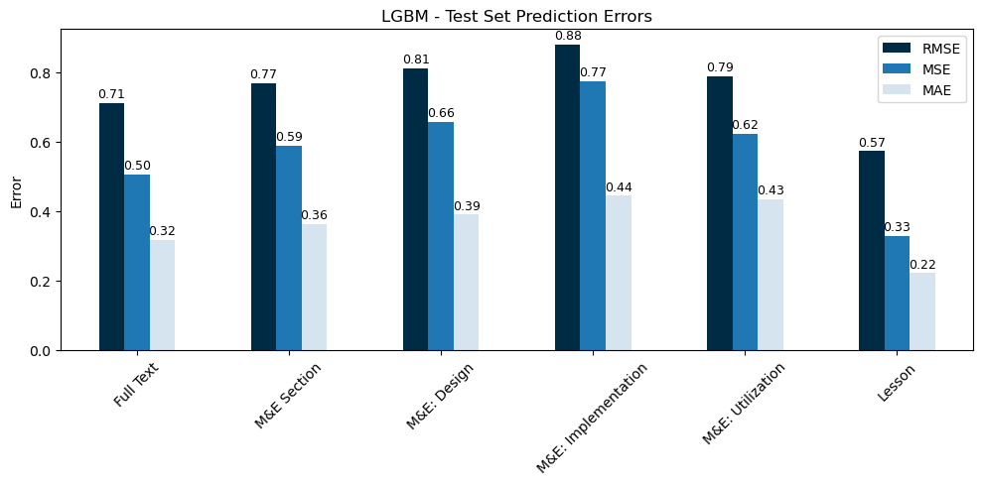
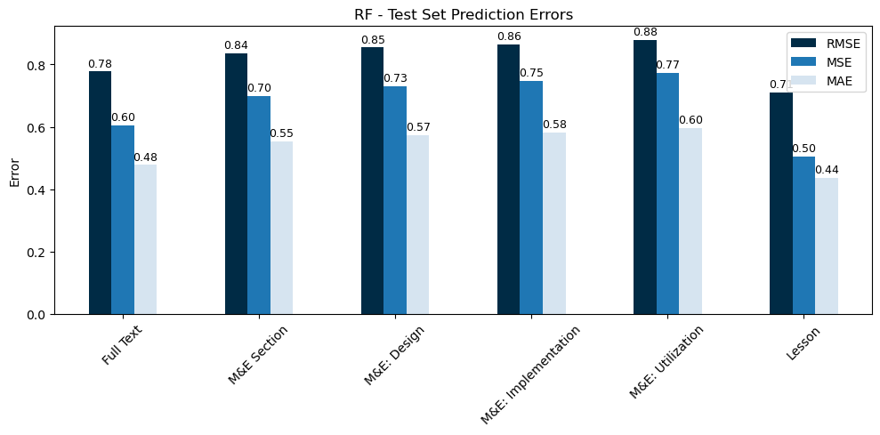
Figure 13. Performance metrics for the best Gradient Boosting and Random Forest models using text from specific sections.

Slide 12
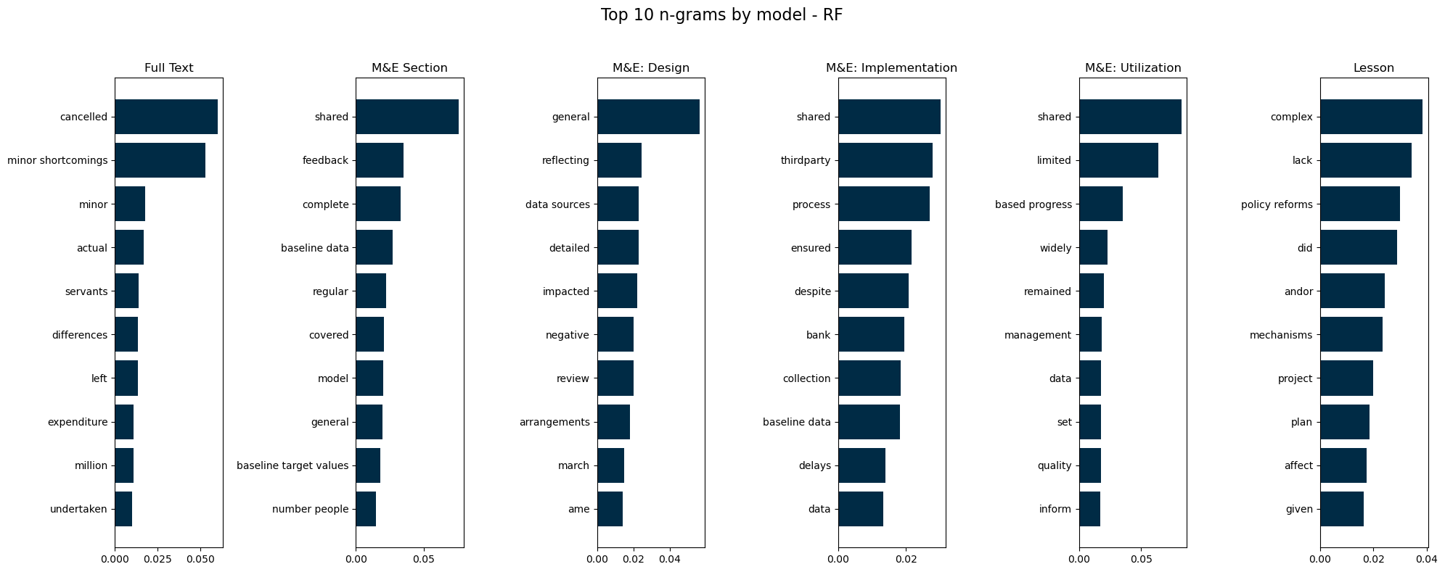
Figure 14. Feature importance in the best Random Forest model using text from specific sections.

